Slide 1
Kernel & Shell

Slide 2
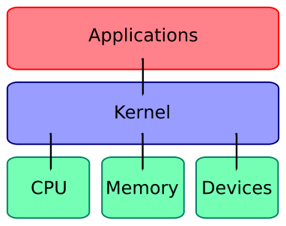
What is a kernel?
A kernel connects
the application
software to the
hardware of a
computer.

Slide 3
What is a Kernel?
An operating system is conceptually broken into two components. A Shell and a Kernel. As the name implies the shell is an outer wrapper to the kernel which in turn talks directly to the hardware.
  Hardware ↔ Kernel ↔ Shell ↔ Applications
In some operating systems the shell and the kernel are completely separate entities, allowing you to run varying combinations of shell and kernel (e.g., Unix), in others their separation is only conceptual (e.g., Windows).

Slide 4
A kernel, defined?
It's hard to specifically say what a kernel is (or isn't).
A kernel is "traditionally used to denote the part of the operating system that is mandatory and common to all other software." -- Jochen Liedtke
Kernel development is considered one of the most complex and difficult tasks in programming.

Slide 5
What is a Kernel ?
Part of the OS that executes as trusted software in supervisor mode (or privileged mode)
Implements basic mechanisms that assure secure operation of the entire OS.
The idea is to identify the parts of the OS that are critical to its correct and efficient operation, and implement only that functionality in the kernel.
Other software (including part of the OS) and all application programs execute as un-trusted software in user mode.

Slide 6
What a kernel does?
The kernel's primary purpose is to manage the computer's resources and allow other programs to run and use these resources
CPU – Process management
Memory – Memory management
Input/Output – Device management

Slide 7
What a kernel does?
The portion of code that performs these core services is called the "Kernel” of the operating system.
The kernel of an operating system is something you will never see (hidden from the user).
It basically enables your programs to execute. It handles events generated by hardware (called interrupts) and software (called system calls), and manages access to resources.
The hardware-event handlers (interrupt handlers) will, for instance, get the number of the key you just pressed and convert it to the corresponding character stored in a buffer so some program can retrieve it.

Slide 8
What a kernel does?
The system calls are initiated by user-level programs, for opening files, starting other programs, etc. Each system call handler will have to check whether the arguments passed are valid, and then perform the internal operation to complete the request.
Most user programs do not directly issue system calls, but instead use a standard library which does the ugly job of formatting arguments as required by the kernel and generating the system call. (For example, the C function fopen() eventually calls a kernel function that actually opens the file.)

Slide 9
The kernel usually defines a few abstractions like files, processes, sockets, directories, etc. which correspond to an internal state it remembers about last operations, so that a program may issue a session of operation more efficiently.
Kernel design ideologies include monolithic kernel, microkernel and exokernel. Among commercial systems, such as Unix and Windows, the monolithic approach is predominant, with a few noted exceptions (eg, QNX). The microkernel approach is more popular among research OS’s.

Slide 10
Operating System Kernel
File
Manager
Process & Resource
Manager
Memory
Manager
Device
Manager
Processor(s)
Main Memory
Devices
Hardware

Slide 11
OS Organization
Application
Application
Application
Shared Runtime Libraries
user-mode
supervisor-mode
System Call Interface
memory
manager
task
manager
file
manager
device
manager
OS Kernel
Hardware

Slide 12
The portion of code that performs these core services is called the "Kernel” of the operating system.
The kernel of an operating system is something you will never see (hidden from the user).
It basically enables your programs to execute. It handles events generated by hardware (called interrupts) and software (called system calls), and manages access to resources.
The hardware-event handlers (interrupt handlers) will, for instance, get the number of the key you just pressed and convert it to the corresponding character stored in a buffer so some program can retrieve it.

Slide 13
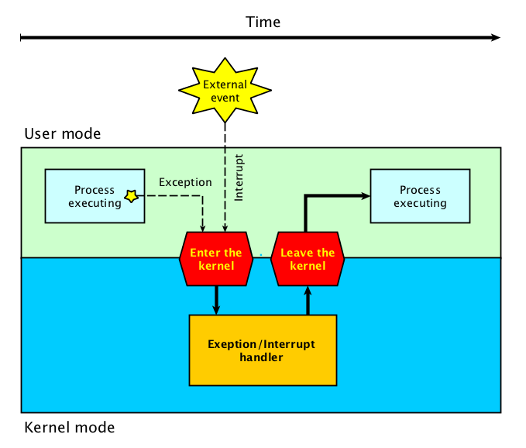
Interrupt Handler

Slide 14
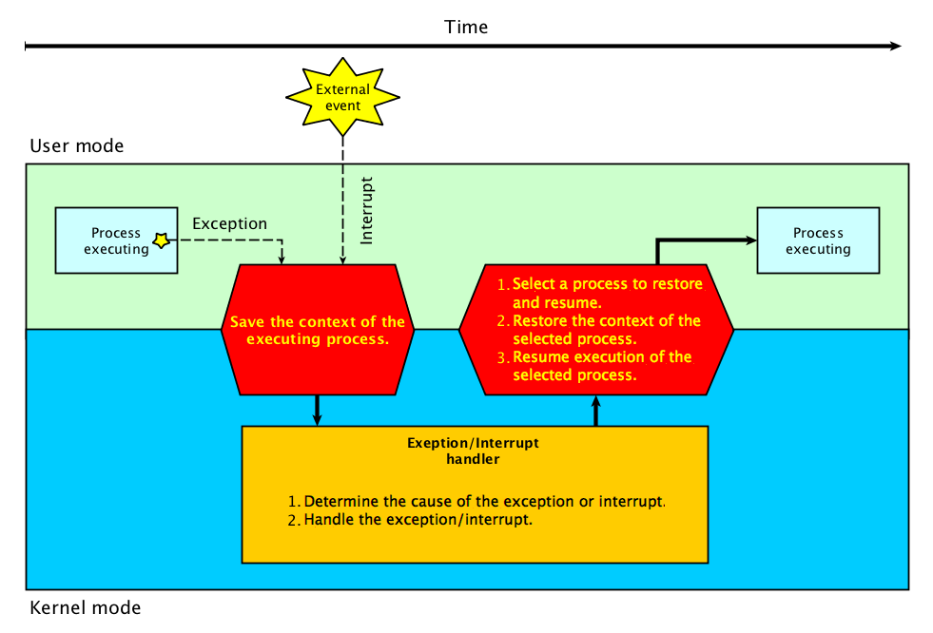
Interrupt Handler

Slide 15
The system calls are initiated by user-level programs, for opening files, starting other programs, etc. Each system call handler will have to check whether the arguments passed are valid, and then perform the internal operation to complete the request.
Most user programs do not directly issue system calls, but instead use a standard library which does the ugly job of formatting arguments as required by the kernel and generating the system call. (For example, the C function fopen() eventually calls a kernel function that actually opens the file.)

Slide 16
The kernel usually defines a few abstractions like files, processes, sockets, directories, etc. which correspond to an internal state it remembers about last operations, so that a program may issue a session of operation more efficiently.
Kernel design ideologies include monolithic kernel, microkernel and exokernel. Among commercial systems, such as Unix and Windows, the monolithic approach is predominant, with a few noted exceptions (eg, QNX). The microkernel approach is more popular among research OS’s.

Slide 17
Trap – software interrupts
UP
User
space
The mode bit is set user mode trap hardware (aka supervisor call) instruction.
The trap instruction is not a privileged instruction.
Branches to a fixed location in the system space
Only the OS routines will be loaded in the system space which is explicitly protected because no user program can load its own code into it.
Requires a relatively long time to execute compared to normal function call.
SP
System
space
Mode
S
Trap table
trap
TrustedCode
User
Supervisor

Slide 18
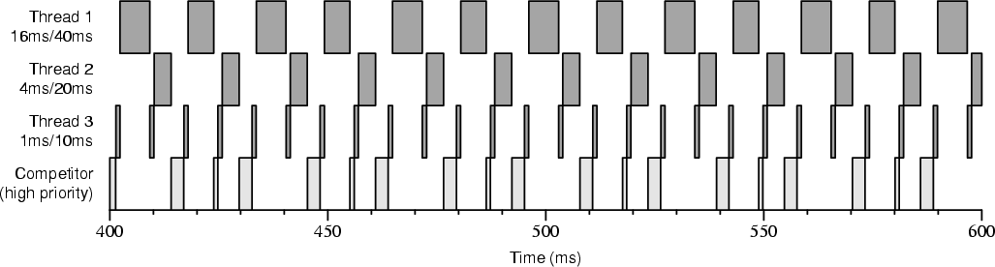
Process management
Basically - running programs
CPU's typically can only run one program at a time
Advanced kernels can “fake” like more than one program is running (time-sharing /multitasking)‏

Slide 19
Time-sharing/Multitasking
Cooperative multitasking
  Cheapo “fake” multitasking, i.e. Windows 95
  Running programs offer to yield to others
  Running programs don't have to yield
  A “hung” program hangs the computer
Pre-emptive multitasking
  “Real” multitasking, like Unix
  The kernel makes programs share whether they want to or not

Slide 20
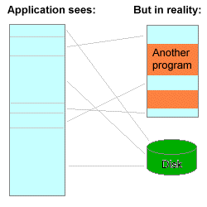
Memory management
Virtual memory – gives programs the “illusion” they are the only user of memory
Good for security, programs
limited to “their” space
“Fools” programs into
thinking they have more
memory than they do

Slide 21
I/O – Device management
Kernels have to handle multitudes of devices that are very different
Device drivers handle I/O with the actual hardware. Users of devices don't have to know the idiosyncrasies of their hardware, as long as they can talk to the driver
Devices need to be serviced in a timely manner

Slide 22
Different kinds of kernels
One key difference is where the drivers live
  In the kernel “kernel space” or outside “user space”
Monolithic – everything, device drivers, etc., live in kernel space
Microkernel – drivers (or “servers”) live in user space
Hybrid – Some drivers in kernel space, others in user space

Slide 23
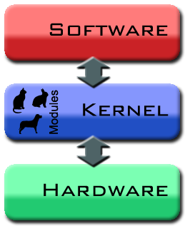
Monolithic kernels
Drivers have direct (quick) access to hardware
Consider “inelegant” and “obsolete” by computer scientists
The larger something is, the more places bugs can hide
Poorly written drivers crash the system
Tend to get big and complicated
Linux is a monolithic kernel
Easier to design and implement

Slide 24
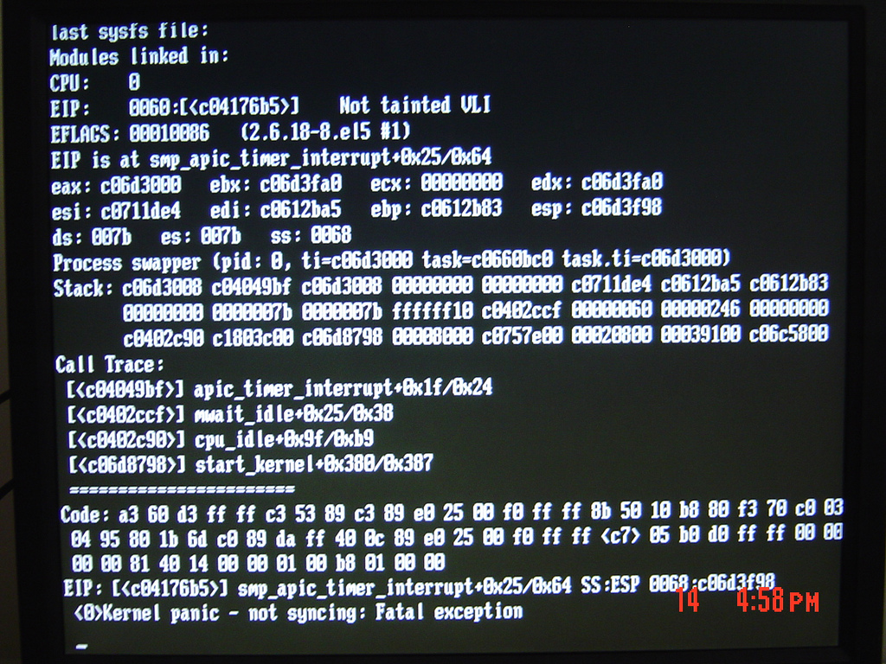
Kernel Panic!

Slide 25
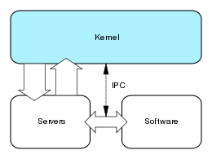
Microkernels
Drivers exist outside the kernel
Harder to design and implement
Well made microkernels are small and easy to debug and maintain
Poorly written drivers cannot crash the system (they run in user space)‏
Most real world examples of microkernels have very poor performance, not in common use

Slide 26
Hybrid kernels
Drivers exist both inside and outside the kernel
Well made hybrids combine advantages from both monokernels and microkernels
Poorly written drivers may crash the system (depends on where they run)‏
Newer versions of Windows (NT and later) are hybrid kernel design

Slide 27
What is a Shell ?
A shell is a special program that is usually integrated in any OS distribution and which offers humans an interface with the kernel. The way it appears to users may vary from system to system (command line, file explorer, etc), but the concept is always the same:
  allow the user to select a program to be started, and optionally give it session-specific arguments
Allow trivial operation on the local storage like listing the content of directories, moving and copying files across the system.

Slide 28
a Shell is a program that provides a command-line interface for interacting with the operating system. A shell is typically the outermost layer of an operating system's user interface, providing a way for users to interact with the system by typing commands, rather than using a graphical user interface.

Slide 29
The shell interprets the commands entered by the user and executes them, usually by calling other programs or system functions. It also provides features such as command history, tab completion, and scripting capabilities that allow users to automate tasks and write more complex sequences of commands.

Slide 30
Examples of popular shells include Bash (which is the default shell on most Linux distributions), PowerShell (which is the default shell on Windows), and zsh (which is popular among users on both Linux and macOS).

Slide 31
In order to complete those actions, the shell may have to issue numerous system calls, like "open file 'x'; open file 'y' and create it if it doesn't exists; read content from X, write into Y, close both files, write "done" to standard output".

